Slide 1


Bangalore Institute of Technology
K.R. Road, V.V. Pura, Bengaluru.-560004.
Department of Computer Science & Engineering
2024-25
"Fake Account Detection on Instagram Using Machine Learning (ANN)"
Presentation by
22MP24
1BI22CS032 BHUMIKA B
1BI22CS043 DEEPTI RAJ
1BI22CS046 DHRUTHI P
1BI22CS196 VARUNI Y K Under the Guidance of
Prof. K.N PRASHANTH KUMAR
Assistant Professor
Department of CSE, BIT

Slide 2
Bangalore Institute of Technology
K.R. Road, V.V. Pura, Bengaluru.-560004.
Department of Computer Science & Engineering
Agenda
Introduction
Existing Systems
Problem Statement
Objectives
Tools and Technologies
Architectural Diagram
Modules Description
Implementation
Results
Applications
Conclusion and Future scope

Slide 3
Bangalore Institute of Technology
K.R. Road, V.V. Pura, Bengaluru.-560004.
Department of Computer Science & Engineering
INTRODUCTION
The widespread use of online social networks (OSNs) has made them prime targets for cyber attackers, who exploit these platforms for various malicious activities. One such activity is the creation and use of fake accounts, which has become a significant issue on platforms like Instagram. The rapid growth of these networks has led to an increase in fraudulent accounts, creating a need for efficient methods to detect fake profiles.
To address this, a machine learning model using an Artificial Neural Network (ANN) is designed to differentiate between real and fake Instagram accounts. The model is built by selecting a subset of relevant features that can effectively identify fake accounts. By focusing on key characteristics of user profiles, the model aims to classify accounts as either real or fake based on their activity and other profile data.

Slide 4
Bangalore Institute of Technology
K.R. Road, V.V. Pura, Bengaluru.-560004.
Department of Computer Science & Engineering
EXISTING SYSTEMS
Drawbacks:
The current methods for detecting fake accounts on platforms like Instagram include:
1. Manual methods - where users or moderators report suspicious accounts, and
2. Rule-based systems - that rely on predefined criteria like unusual username patterns or
spikes in activity.
These approaches are often time-consuming, inflexible, and struggle to adapt to sophisticated tactics used by fake accounts, such as bots mimicking human behavior.
The traditional algorithms like Decision Trees and Logistic regression are relatively easy to implement and interpret, making them a good starting point.
However, their limitation lies in their inability to effectively capture complex, non-linear relationships within user behavior.

Slide 5
Bangalore Institute of Technology
K.R. Road, V.V. Pura, Bengaluru.-560004.
Department of Computer Science & Engineering
Additionally, current systems frequently suffer from high false positive and negative rates and lack real-time adaptability.
Benefits Of ANN Approach:
Ability to Learn Complex Relationships: ANNs have the flexibility to learn these complex patterns without requiring explicit manual feature engineering. This makes them especially useful when relationships between features are hard to capture using simpler models like Logistic Regression or Decision Trees.
Handling High Dimensionality: ANNs can reduce the risk of overfitting and learn the optimal representation for each feature in high-dimensional spaces.

Slide 6
Bangalore Institute of Technology
K.R. Road, V.V. Pura, Bengaluru.-560004.
Department of Computer Science & Engineering
Scalability and Adaptability: ANNs, especially deep learning models, are highly scalable and can continue improving with larger datasets. They can adapt more effectively to new, unseen data, allowing to handle the evolving nature of fake accounts.
No Need for Explicit Feature Engineering: ANNs are able to automatically learn feature representations, including complex relationships between numeric features.

Slide 7
Bangalore Institute of Technology
K.R. Road, V.V. Pura, Bengaluru.-560004.
Department of Computer Science & Engineering
PROBLEM STATEMENT
To develop an efficient machine learning model that can automatically identify and classify fake Instagram accounts by analyzing various user profile attributes and activity patterns. The goal is to reduce the prevalence of fake accounts on the platform by providing a reliable mechanism for account verification.
Input:
User profile details such as username, full name, bio description, profile picture type, external URLs, number of posts, followers, following, and account privacy status. Activity metrics including frequency of posts, interaction patterns (likes, comments), and time of activity.
Output:
Classification of the account as either fake or real based on the analysis of the input data that the user enters.

Slide 8
Bangalore Institute of Technology
K.R. Road, V.V. Pura, Bengaluru.-560004.
Department of Computer Science & Engineering
OBJECTIVES
To build a scalable and robust framework model that can handle large real datasets and adapt to evolving fake account tactics.
To implement an Artificial Neural Network model capable of analyzing user account details and profile data for effective fake account detection.
To design a user-friendly model that predicts and detects fake Instagram accounts based on input data where the user can just provide in the details on the web page and find the solution without getting through the complexity of the model

Slide 9
Bangalore Institute of Technology
K.R. Road, V.V. Pura, Bengaluru.-560004.
Department of Computer Science & Engineering
TOOLS AND TECHNOLOGIES
Data Analysis and Visualization:
- Python
Front-End:
- HTML
- CSS
API :
- Flask
Back-End:
- Python
- Machine Learning Model: ANN
- Dataset : CSV files (train & test) sourced from Kaggle

Slide 10
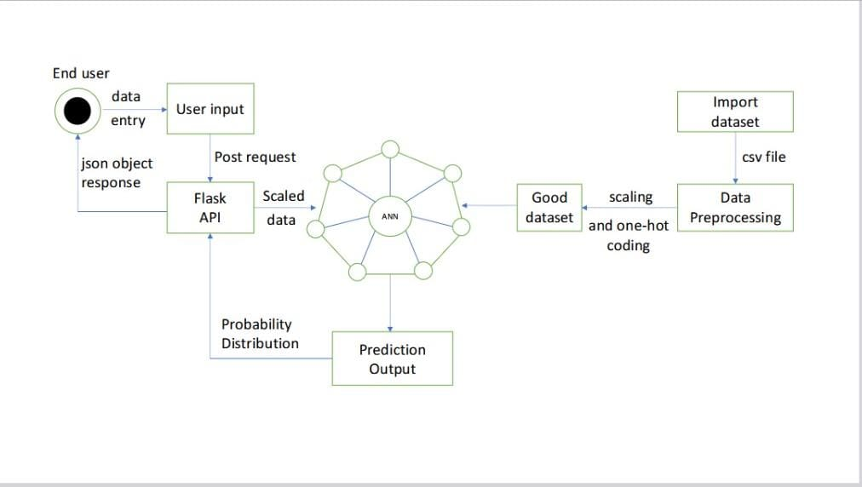
Bangalore Institute of Technology
K.R. Road, V.V. Pura, Bengaluru.-560004.
Department of Computer Science & Engineering
ARCHITECTURAL DIAGRAM

Slide 11
Bangalore Institute of Technology
K.R. Road, V.V. Pura, Bengaluru.-560004.
Department of Computer Science & Engineering
MODULES DESCRIPTION
Importing Dataset
The project imports the training and testing datasets from Kaggle, which provide the necessary data for training and evaluating the model to detect fake social media accounts.
2. Data Preprocessing
Input Features (X): Extracts all columns except the target column ('fake') as input features for training (X_train) and testing (X_test).
Target Variable (y): Extracts the 'fake' column as the output/target variable for training (y_train) and testing (y_test).

Slide 12
Bangalore Institute of Technology
K.R. Road, V.V. Pura, Bengaluru.-560004.
Department of Computer Science & Engineering
Feature Scaling: Uses Standard Scaler to standardize the input features (X_train and X_test) by removing the mean and scaling to unit variance, ensuring the model trains effectively.
One-Hot Encoding: Converts the target variable (y_train and y_test) into a categorical format with two classes {e.g., 0 (Real) will be converted to [1, 0] (indicating "real")and1 (Fake) will be converted to [0, 1] (indicating "fake")}to match the output format required by the ANN model.
3. ANN
The Artificial Neural Network (ANN), Backbone of our project is designed to classify Instagram accounts as "real" or "fake" based on various user attributes.
.

Slide 13
Bangalore Institute of Technology
K.R. Road, V.V. Pura, Bengaluru.-560004.
Department of Computer Science & Engineering
Input Layer: Receives 11 features (e.g., profile picture, username length, followers, etc.) from the dataset.
Dense Layers: The first dense layer has 50 neurons with ReLU activation and L2 regularization to learn from input features. Two additional dense layers with 150 neurons and ReLU activation are used to learn more complex patterns. A final dense layer with 25 neurons continues learning the relationships.
Dropout Layers: Added after dense layers with a 30% rate to prevent overfitting by randomly deactivating neurons during training.
Output Layer: A softmax layer with 2 neurons (for "real" and "fake") to output probability scores for each class

Slide 14
Bangalore Institute of Technology
K.R. Road, V.V. Pura, Bengaluru.-560004.
Department of Computer Science & Engineering
Model Compilation: Uses the Adam optimizer with a learning rate of 0.0001. Categorical cross-entropy loss function is used for multi-class classification.
Training: The model is trained for 50 epochs on the preprocessed data, with a validation split of 10% to evaluate its performance.
4. Flask API
Python Flask serves as the backend framework that connects the trained Artificial Neural Network (ANN) model with the user interface.

Slide 15
Bangalore Institute of Technology
K.R. Road, V.V. Pura, Bengaluru.-560004.
Department of Computer Science & Engineering
User Input Handling: Flask receives user input data from the frontend (e.g., via an HTML form or a JSON request) through the POST method. This input includes features such as profile picture presence, username length, followers, and more.
Pre-processing Data: Converts input into the required format, reshaping input features to required dimensions and scaling using the preloaded scaler to ensure consistency with the ANN model’s training
Model Prediction: Uses the ANN model to predict whether an account is "Real" or "Fake."
Output Generation: Sends prediction results JSON format to front end which is displayed in web interface to end user through a user-friendly HTML-based web interface.

Slide 16
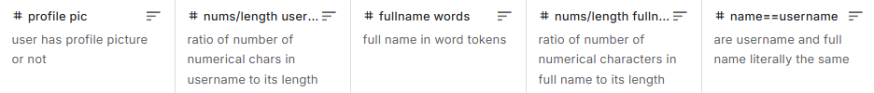
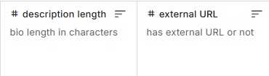
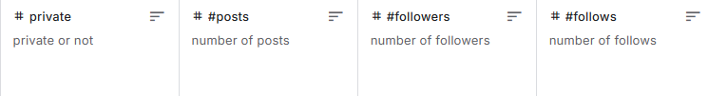
Bangalore Institute of Technology
K.R. Road, V.V. Pura, Bengaluru.-560004.
Department of Computer Science & Engineering
5. Predicted Output :
Model Output: A probability vector of length 2, where each value corresponds to the likelihood of each class.
Predicted Class: The class with the highest probability (0 or 1).
6. End User:
User inputs 11 numeric input fields in a form, presses the predict button and an answer
(real/fake) is generated.
.

Slide 17
Bangalore Institute of Technology
K.R. Road, V.V. Pura, Bengaluru.-560004.
Department of Computer Science & Engineering
IMPLEMENTATION
1)Scaling The Data
Input
- Training and testing features (X_train, X_test)
- Training and testing labels (y_train, y_test)
Output
- Scaled features (X_train, X_test)
- One-hot encoded labels (y_train, y_test)
Pseudocode
1. Initialize a StandardScaler for feature scaling.
2. Scale X_train (fit and transform) and X_test (transform only).
3. Convert y_train and y_test to one-hot encoded format for classification.
4. Output the processed X_train, X_test, y_train, and y_test for model training.

Slide 18
Bangalore Institute of Technology
K.R. Road, V.V. Pura, Bengaluru.-560004.
Department of Computer Science & Engineering
2)Training The Model
2. Model performance during training and validation.
Pseudocode:
1. Model Initialization:
- Use a Sequential model to stack layers.
Input:
Training Data:
X_train: Features of the dataset
y_train: Labels indicating whether the
account is (0) or (1).
Validation Data: 10% of the training data is
used for model validation during training.
Output:
A trained Artificial Neural Network (ANN) for
classifying accounts as real or fake.

Slide 19
Bangalore Institute of Technology
K.R. Road, V.V. Pura, Bengaluru.-560004.
Department of Computer Science & Engineering
2. Add the Layers:
Input Layer: 11 features
Hidden Layers:
-First: 50 neurons, ReLU, L2 regularization.
-Second: 150 neurons, ReLU.
- Dropout: 30% for regularization.
- Third: 150 neurons, ReLU.
- Dropout: Another 30%.
- Fourth: 25 neurons, ReLU.
- Dropout: 30%.
Output Layer: 2 neurons, Softmax for classification.
3. Compile Model:
Optimizer: Adam, learning rate 0.0001
Loss Function: Categorical Cross-Entropy Metric: Accuracy.
4. Train Model: Train for 50 epochs, using 10% of data for validation

Slide 20
Bangalore Institute of Technology
K.R. Road, V.V. Pura, Bengaluru.-560004.
Department of Computer Science & Engineering
3)FLASK
Pseudocode
1. Initialize Flask App
- Set up Flask and import required libraries.
2. Load Model and Scaler
- Load the trained ANN model and scaler.
3. Accept JSON input, extract and preprocess features, scale input using the scaler, use the model to predict if the account is REAL or
FAKE. Return the result as JSON.
4. Run the Application
- Start Flask on 127.0.0.1:5000.
Input
JSON data with account features
(e.g., profile picture, followers, posts, etc.).
Output
JSON response:
REAL: Indicates a real account.
FAKE: Indicates a fake account.

Slide 21
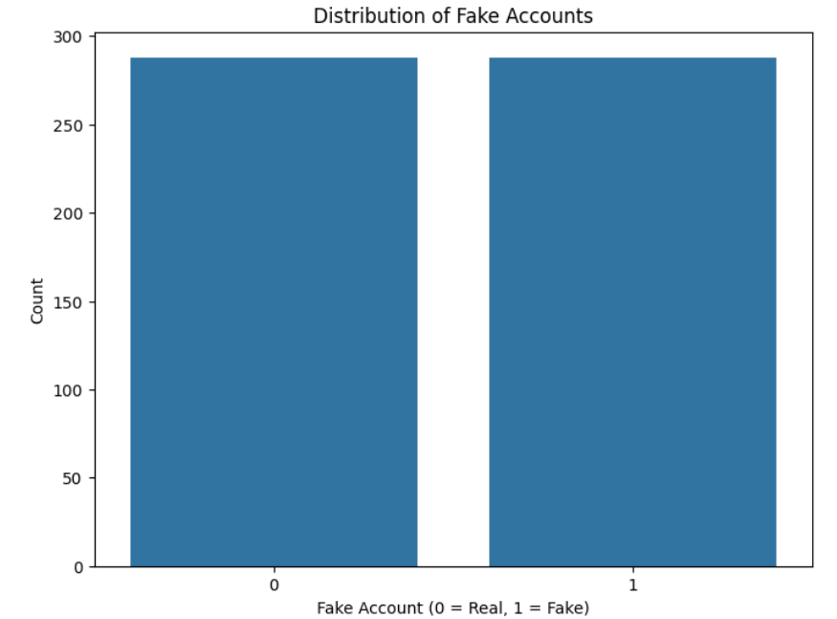
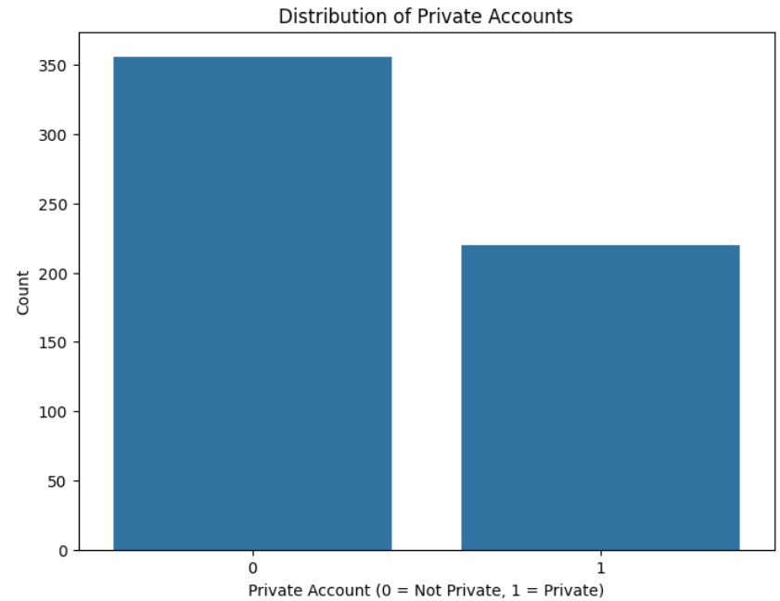
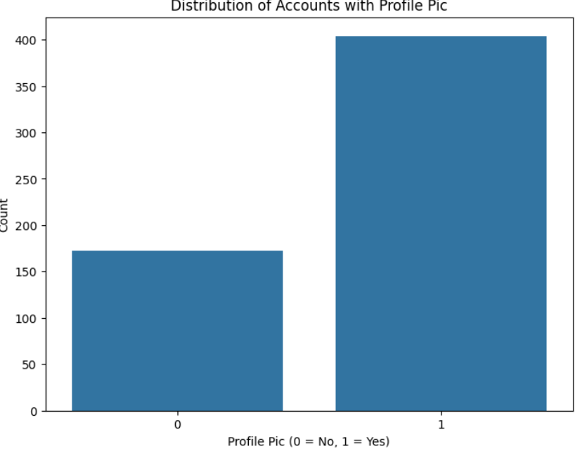
Bangalore Institute of Technology
K.R. Road, V.V. Pura, Bengaluru.-560004.
Department of Computer Science & Engineering
RESULTS
Fig 1: Visualization of Train Dataset

Slide 22
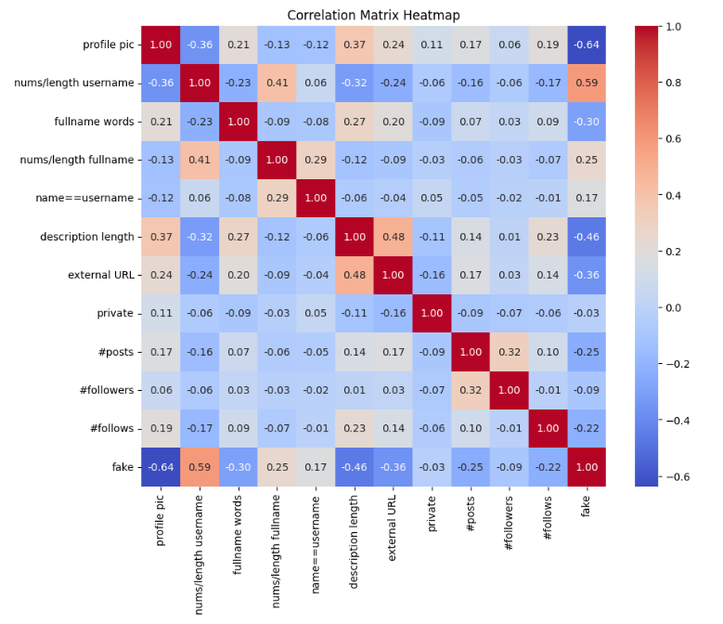
Bangalore Institute of Technology
K.R. Road, V.V. Pura, Bengaluru.-560004.
Department of Computer Science & Engineering
Fig 2: Correlation Matrix Heatmap

Slide 23
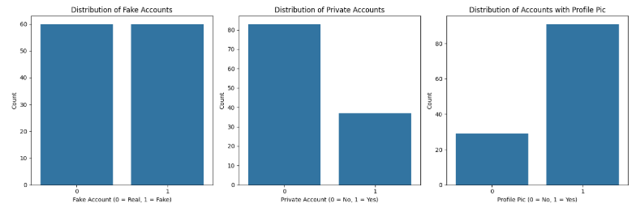
Bangalore Institute of Technology
K.R. Road, V.V. Pura, Bengaluru.-560004.
Department of Computer Science & Engineering
Fig 3: Visualization of Test Dataset

Slide 24
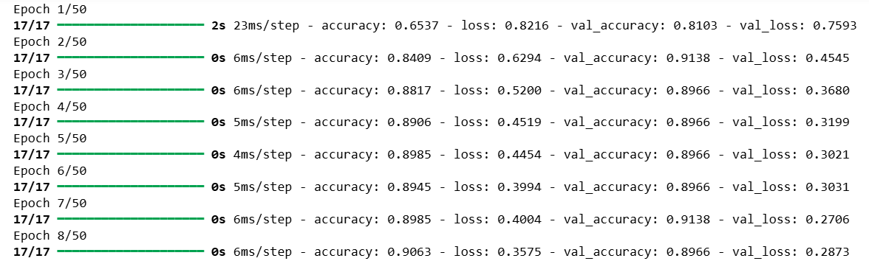
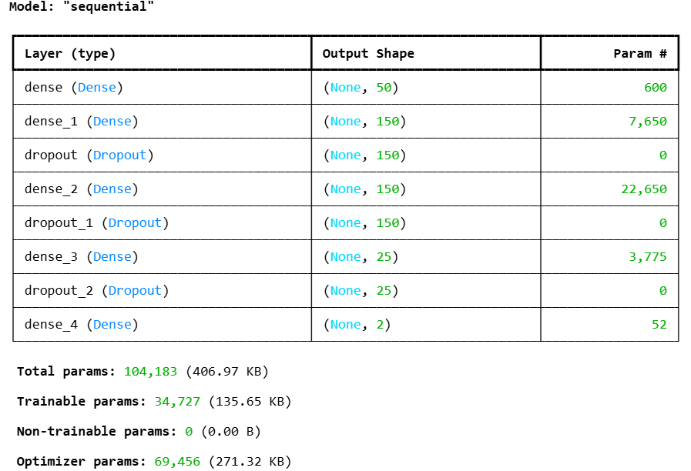
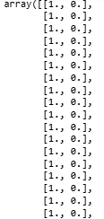
Bangalore Institute of Technology
K.R. Road, V.V. Pura, Bengaluru.-560004.
Department of Computer Science & Engineering
Fig 4: Training Process
Fig 6: Model Summary
Fig 5: One-hot encoding

Slide 25
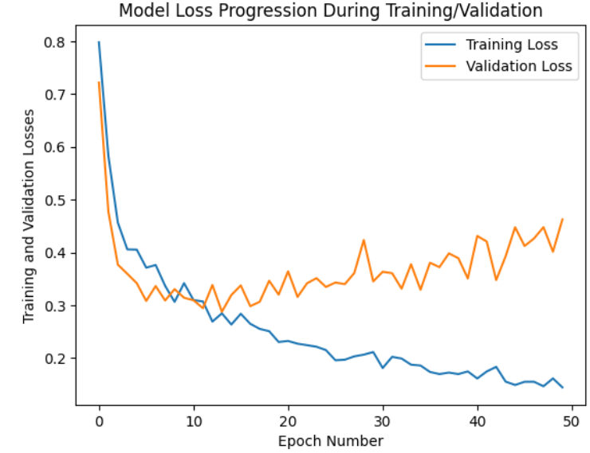
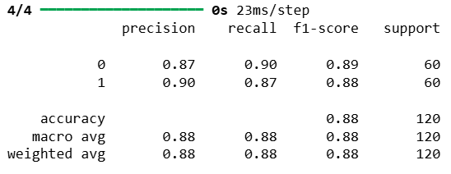
Bangalore Institute of Technology
K.R. Road, V.V. Pura, Bengaluru.-560004.
Department of Computer Science & Engineering
Fig 8: Classification Report
Fig 7: Model Loss Progression During Training/Validation

Slide 26
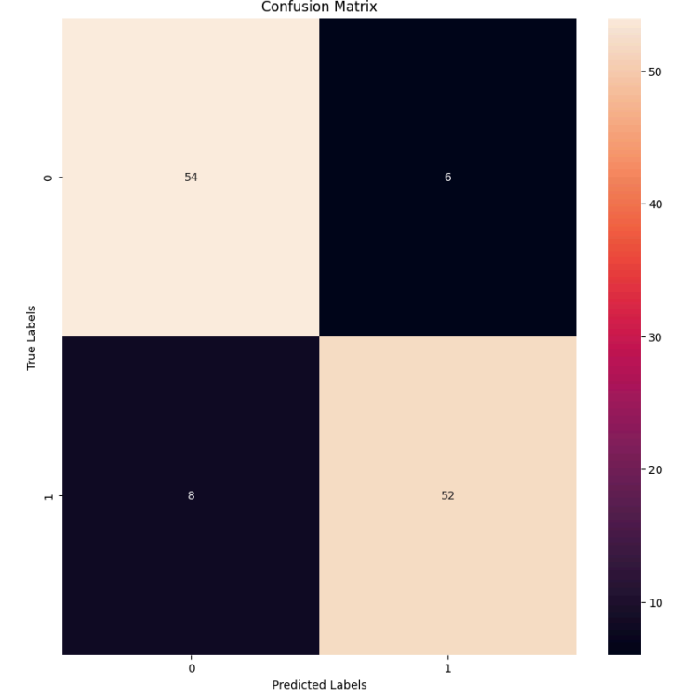
Bangalore Institute of Technology
K.R. Road, V.V. Pura, Bengaluru.-560004.
Department of Computer Science & Engineering
Fig 9: Confusion Matrix

Slide 27
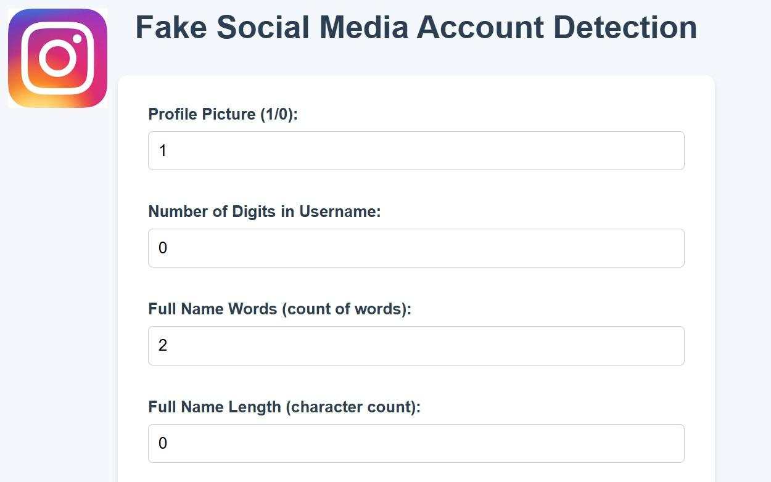
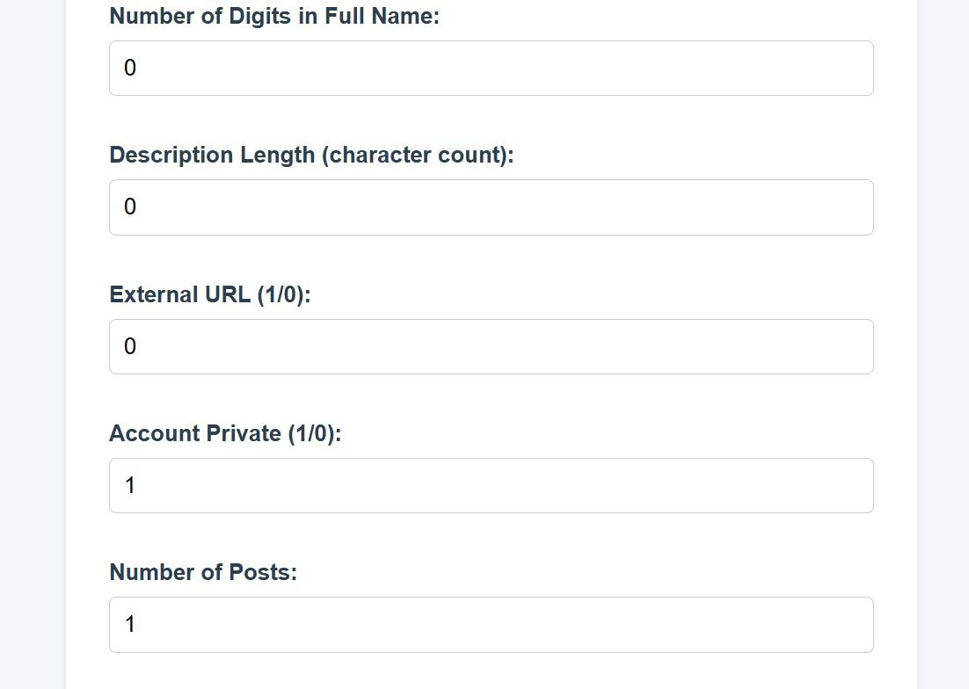
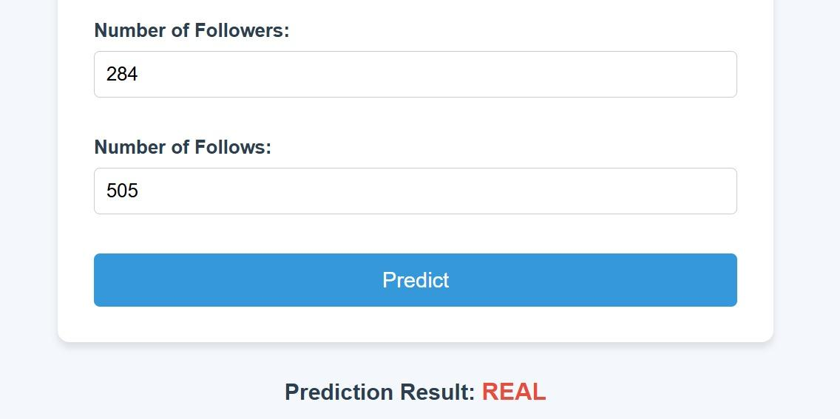
Bangalore Institute of Technology
K.R. Road, V.V. Pura, Bengaluru.-560004.
Department of Computer Science & Engineering
Fig 10: Prediction-Real

Slide 28
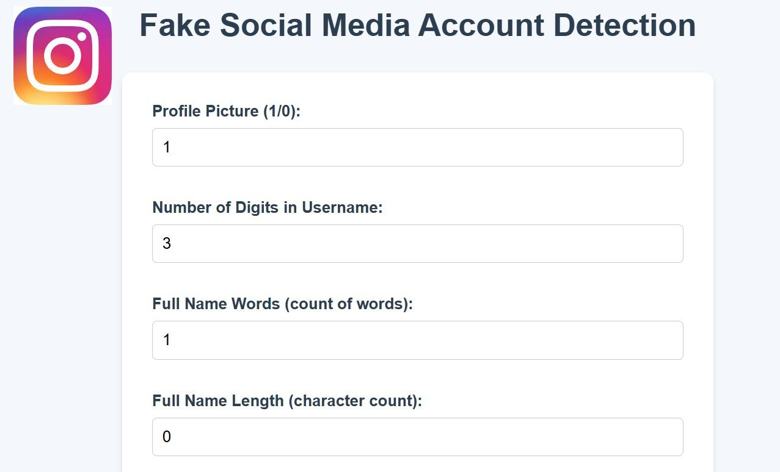
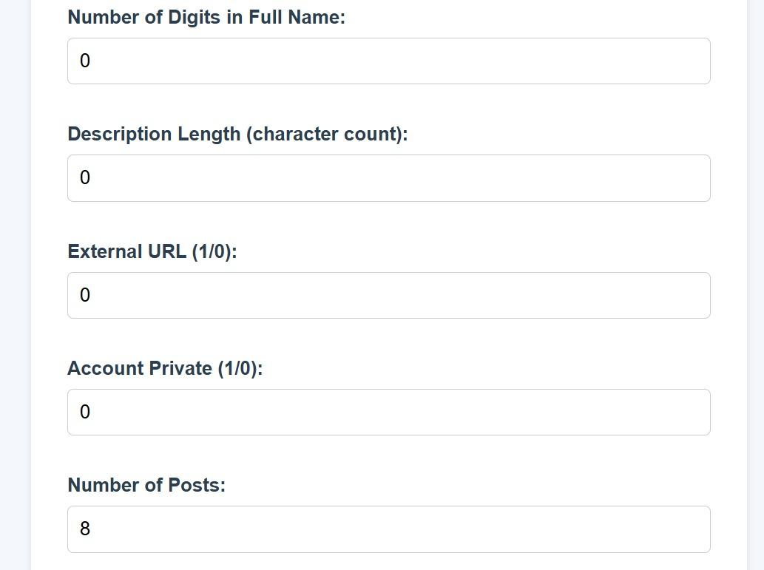
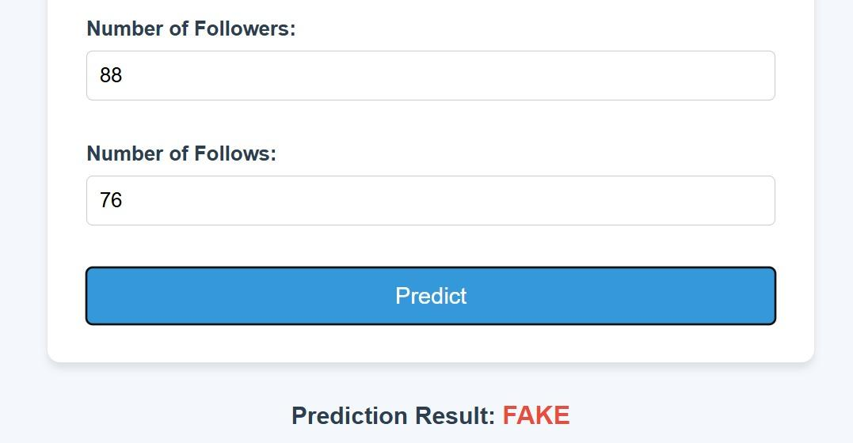
Bangalore Institute of Technology
K.R. Road, V.V. Pura, Bengaluru.-560004.
Department of Computer Science & Engineering
Fig 10: Prediction-Fake

Slide 29
Bangalore Institute of Technology
K.R. Road, V.V. Pura, Bengaluru.-560004.
Department of Computer Science & Engineering
APPLICATIONS
Financial Fraud Prevention
Threat Detection
Identity Protection
Online Harassment Prevention
Online Marketing and Brand Protection For Small Buisnesses

Slide 30
Bangalore Institute of Technology
K.R. Road, V.V. Pura, Bengaluru.-560004.
Department of Computer Science & Engineering
CONCLUSION AND FUTURE WORK
The project successfully demonstrates the use of an Artificial Neural Network (ANN) to detect fake accounts on Instagram with high accuracy. ANN also helps to find the solution to complex relations of the data. This solution addresses limitations of traditional systems, such as inefficiency in handling evolving tactics and large-scale data.
The model leverages TensorFlow for training and inference and utilizes scaling techniques (StandardScaler) to normalize the data, ensuring that it is consistent with the format used during training.
This project is a practical application of machine learning in the context of social media, addressing a growing concern in today's digital landscape. It provides a user-friendly interface to detect fake accounts, addressing the growing threat of Cybercrime.

Slide 31
Bangalore Institute of Technology
K.R. Road, V.V. Pura, Bengaluru.-560004.
Department of Computer Science & Engineering
Future Scope:
Integrating the system with social media platforms APIs to allow automatic detection and reporting of fake accounts.
Implementation for other OSNs(Online Social Networks).
As cybercriminals continually evolve their strategies, it's important to evolve the model and consider newer features to counteract emerging threats.

Slide 32
Bangalore Institute of Technology
K.R. Road, V.V. Pura, Bengaluru.-560004.
Department of Computer Science & Engineering
THANK YOU

